Slide 1


Corruption-Tolerant Asynchronous $Q−$Learning with Near-Optimal Rates
Sreejeet Maity Aritra Mitra
Department of Electrical and Computer Engineering
North Carolina State University, Raleigh

Slide 2



Are RL algorithms always trustworthy ?
RL algorithms learn from feedback.
How critical is the assumption of “perfect” feedback in practical scenarios?
In real-world settings, feedback can be noisy, contain outliers, or even be maliciously corrupted.
Action
Feedback
Agent
Environment
$$+$$
$$+$$
=
True
Feedback
Noise
Adversary
Corrupted
Feedback
How “reliable” are RL Algorithms in such real-world settings ?

Slide 3
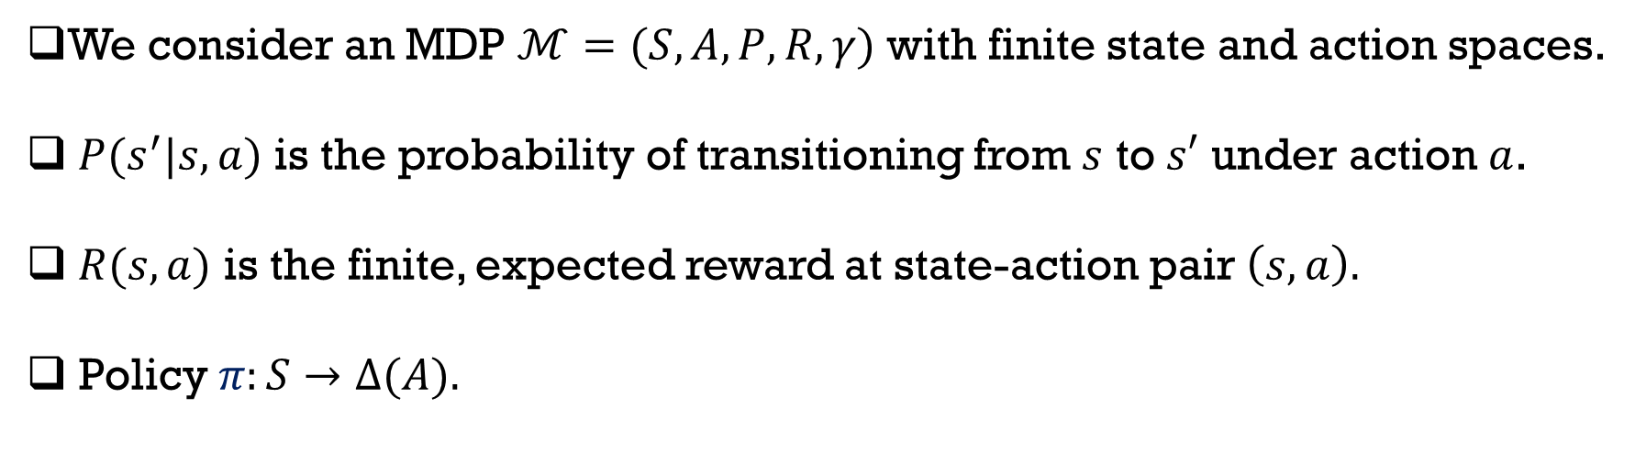



$Q−$Learning: Estimating Action Values
We consider an MDP $ℳ=(S,A, P, R, γ)$ with finite state and action spaces.
$P(s^{′}|s,a)$ is the probability of transitioning from $s$ to $s′$ under action $a$.
$R(s,a)$ is the finite, expected reward at state-action pair $\left(s,a\right).$
Policy $π:S→Δ(A).$
For a fixed policy $π$, we define $Q_{π}:S×A↦ℝ$:
${ Q}_{π}\left(s,a\right)=𝔼 \left[\sum_{t=0}^{∞}{γ^{t}R\left(s_{t},a_{t}\right)|s_{0}=s}, a_{0}=a, π\right]$.
$${ Q}^{∗}\left(s,a\right)=\max_{π}{ Q}_{π}\left(s,a\right); π^{∗}\left(s\right)=\underset{ a∈A }{arg max}{Q^{∗}\left(s,a\right)}.$$
How to find $Q^{∗} ?$(Watkins et al., 1988)

Slide 4
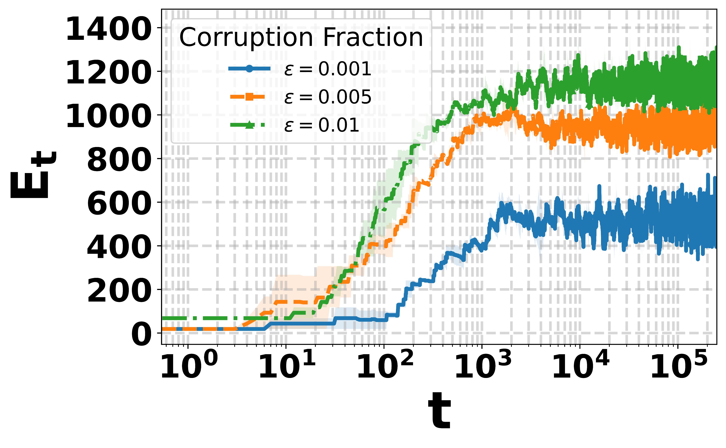

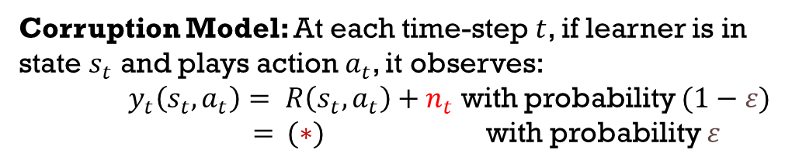

$Q−$Learning: Estimating Action Values
Action
Corruption Model: At each time-step $t$, if learner is in state $s_{t}$ and plays action $a_{t}$, it observes:
$y_{t}\left(s_{t}, a_{t}\right)= R\left(s_{t},a_{t}\right)+n_{t}$ with probability $(1−ε)$
$=$ $(∗)$ with probability $ε$
$n_{t}$: Heavy-tailed noise, finite variance; ($∗):$ Arbitrary.
New observation sequence:$𝓓_{t}=\{s_{t},a_{t},y_{t}\left(s_{t},a_{t}\right),s_{t+1}\}$.
Agent
Environment
$$+$$
$$+$$
=
Noise
Adversary
Vanilla $Q−$Learning with corrupted feedback
Vanilla $Q−$Learning [1] fails catastrophically!
[1] C. J. Watkins and P. Dayan, “Q-learning,” Machine learning, 1992.

Slide 5



Towards Robust $Q−$Learning
Idea 1: Use historical data to build robust estimates of reward means. What about rare events?
Idea 2: Reject estimates that deviate “too much” from expected bounds. How to design rejection threshold?
$$s∈S$$
$$A$$

Slide 6




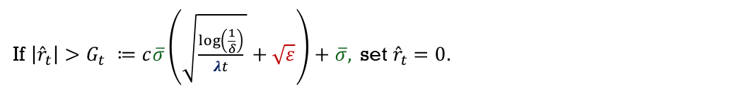


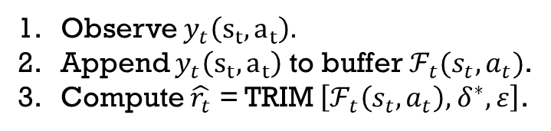


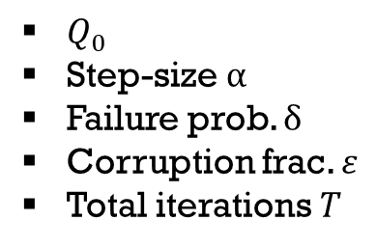

Components of Robust $Q−$Learning
$Q_{0}$
Step-size $α$
Failure prob. $δ$
Corruption frac. $ε$
Total iterations $T$
Observe $y_{t}\left(s_{t},a_{t}\right).$
Append $y_{t}\left(s_{t},a_{t}\right)$ to buffer $ℱ_{t}(s_{t},a_{t})$.
Compute $\hat{r_{t}}$ = TRIM $\left[ℱ_{t}\left(s_{t},a_{t}\right)\text{, }δ^{∗}, ε\right]$.
$$G_{t}$$
$$G_{t}$$
$$\tilde{r_{t}}$$
$$0$$
Typical region for ${\hat{r}}_{t}$
If $\left|{\hat{r}}_{t}\right|>G_{t} ≔c\overline{σ}\left(\sqrt{\frac{\log\left(\frac{1}{δ}\right)}{λt} }+\sqrt{ε}\right)+\overline{σ},$set ${\hat{r}}_{t}=0.$
$$\left|{\hat{r}}_{t}−R\left(s_{t},a_{t}\right)\right|≤c\overline{σ}\left(\sqrt{\frac{\log\left(\frac{1}{δ}\right)}{λt} }+\sqrt{ε}\right)$$
Corruption fraction
$\overline{σ}=\max\left(σ, \overline{R}\right),$ where $σ^{2}$ is noise variance and $\left|R\left(s,a\right)\right|≤\overline{R}, ∀s,a$.
Minimum visitation probability
Robust $Q$-Learning Update
$$Q_{t+1}\left(s_{t},a_{t}\right)=\left(1−α_{t}\right)Q_{t}\left(s_{t},a_{t}\right)+α_{t}\left(\tilde{r_{t}} +γ\max_{a^{′}∈A}{Q_{t}\left(s_{t+1},a^{′}\right)}\right)$$

Slide 7
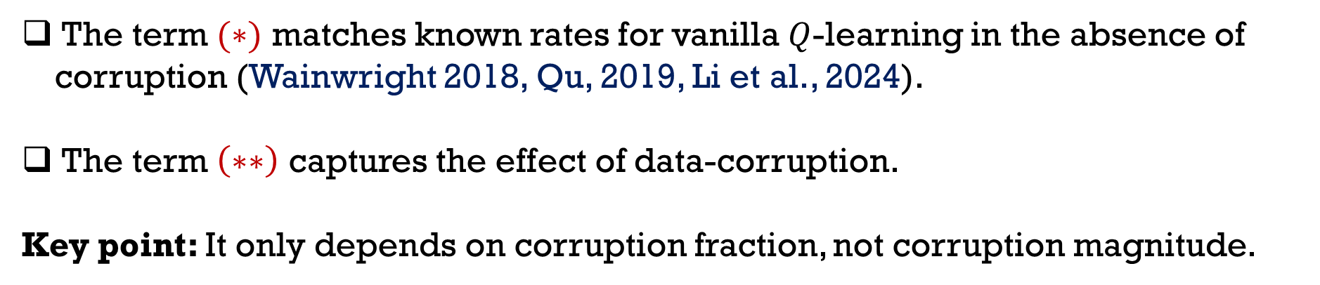


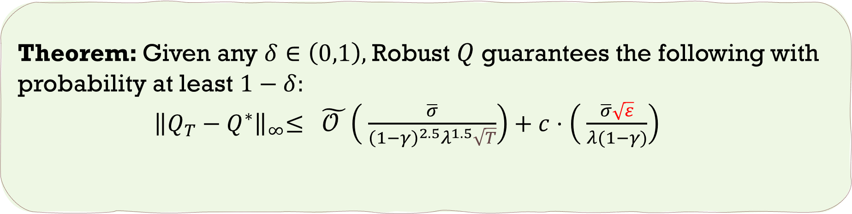
Convergence Guarantee of Robust $Q−$Learning
Theorem: Given any $δ∈\left(0,1\right),$Robust $Q$guarantees the following with probability at least $1−δ:$
${ \left\|Q_{T}−Q^{∗}\right\|}_{∞}≤ \tilde{𝒪 }\left( \frac{\overline{σ}}{{\left(1−γ\right)}^{2.5}λ^{1.5}\sqrt{T}}\right)+c⋅\left( \frac{\overline{σ}\sqrt{ε}}{λ(1−γ)}\right)$
$$(∗)$$
$$(∗∗)$$
The term $(∗)$ matches known rates for vanilla $Q$-learning in the absence of corruption (Wainwright 2018, Qu, 2019, Li et al., 2024).
The term $\left(∗∗\right)$ captures the effect of data-corruption.
Key point: It only depends on corruption fraction, not corruption magnitude.
Notes:
.

Slide 8


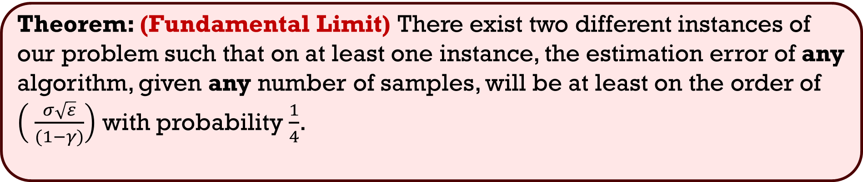
Information-Theoretic Fundamental Limits
MDP with one state and one action.
Robust Mean Estimation in Rewards.
World 1 $$Q_{1}$$
World 2
$$Q_{2}$$
Learner cannot distinguish!
Learner performs
Poorly in one such
world.
$$\left|Q_{1}−Q_{2}\right|≥\frac{C\overline{R}\sqrt{ε}}{2\left(1−γ\right)}$$
Theorem: (Fundamental Limit) There exist two different instances of our problem such that on at least one instance, the estimation error of any algorithm, given any number of samples, will be at least on the order of $\left( \frac{σ\sqrt{ε}}{(1−γ)}\right)$ with probability $\frac{1}{4}$.

Slide 9
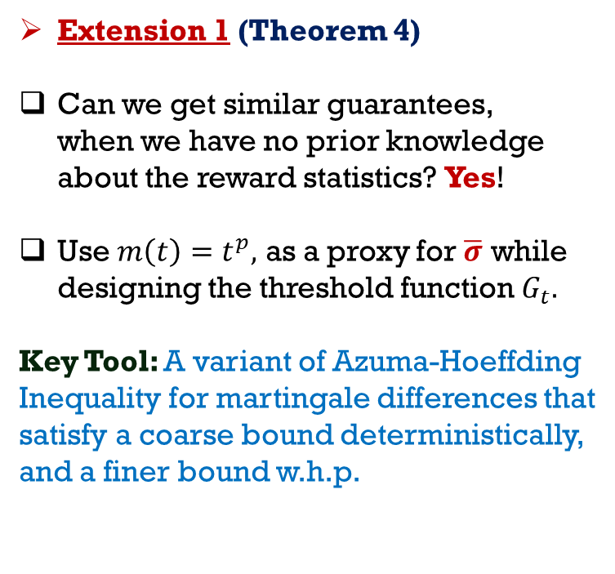
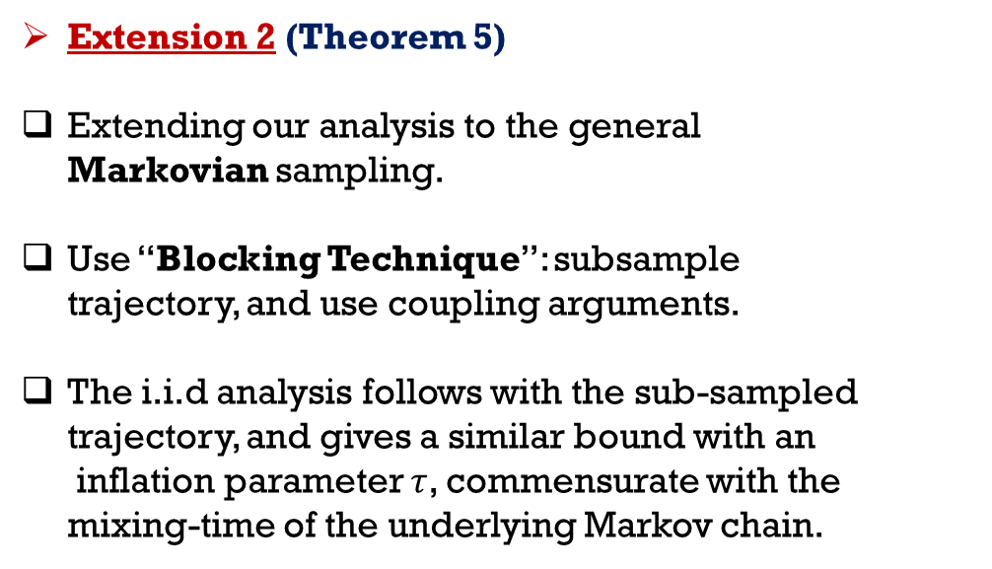
Extensions
Extension 1 (Theorem 4)
Can we get similar guarantees, when we have no prior knowledge about the reward statistics? Yes!
Use $m\left(t\right)=t^{p},$ as a proxy for $\overline{σ}$ while designing the threshold function $G_{t}.$
Key Tool: A variant of Azuma-Hoeffding
Inequality for martingale differences that satisfy a coarse bound deterministically, and a finer bound w.h.p.
Extension 2 (Theorem 5)
Extending our analysis to the general Markovian sampling.
Use “Blocking Technique”: subsample
trajectory, and use coupling arguments.
The i.i.d analysis follows with the sub-sampled trajectory, and gives a similar bound with an inflation parameter $τ$, commensurate with the mixing-time of the underlying Markov chain.

Slide 10
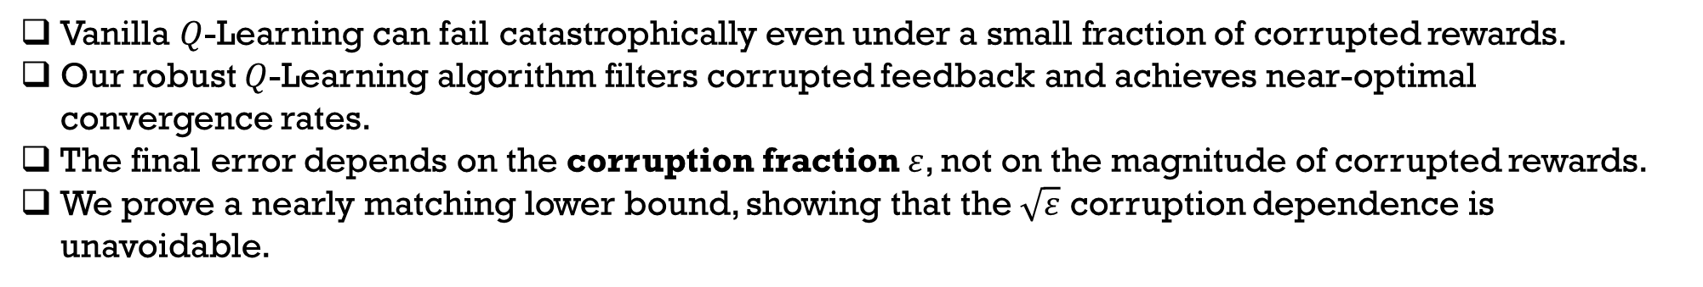
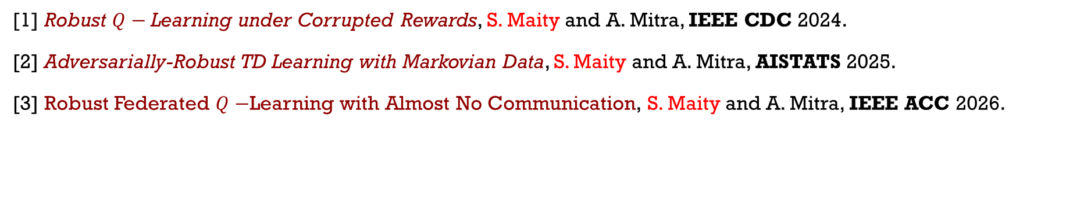
Summary and Related Works
Vanilla $Q$-Learning can fail catastrophically even under a small fraction of corrupted rewards.
Our robust $Q$-Learning algorithm filters corrupted feedback and achieves near-optimal convergence rates.
The final error depends on the corruption fraction $ε$, not on the magnitude of corrupted rewards.
We prove a nearly matching lower bound, showing that the $\sqrt{ε}$ corruption dependence is unavoidable.
First tight finite-sample analysis of $Q$-Learning under adversarial reward feedback, with matching upper bound and lower bound.
Related Works:
[1] Robust $Q−$Learning under Corrupted Rewards, S. Maity and A. Mitra, IEEE CDC 2024.
[2] Adversarially-Robust TD Learning with Markovian Data, S. Maity and A. Mitra, AISTATS 2025.
[3] Robust Federated $Q−$Learning with Almost No Communication, S. Maity and A. Mitra, IEEE ACC 2026.

